Slide 1
Internal Presenter Notes: What Attendees Should Take Away
Understand query performance in a relational DW in Azure Synapse Analytics
Obtaining maximum query performance
Monitor and tune query performance

Slide 3
Optimize data warehousing query performance
Speaker name
Title
Notes:
Introductions: Hi, my name is <speaker name> and in this session, optimize data warehousing query performance
To ensure optimal performance of their analytics solution and deliver insights to the entire organization, TailWind Traders implements best practices to maximize scale and throughput.
PRESENTER NOTE: Validate whether all attendees attended DATA30 and DATA40 session, if not, you likely have to spend a bit more time on the initial slides which otherwise will be a refresh.
As a presenter, I encourage you to think about use case scenarios and how they apply to your own, or your customers business problems, and how you see the potential of how you can help providing better insights through Cloud Scale Analytics.
I appreciate and welcome questions <pick your own preference here>:
During my presentation
During the presentation, but realize that not all your questions might be addressed, so might defer you to the Q&A section of this presentation
At the end of the presentation

Slide 4
Resources
Session Resources Hub
aka.ms/DATA50
Session Code on GitHub
aka.ms/DATA50Repo
All Event Session Resources
aka.ms/mymsignitethetour

Slide 5
Agenda
What is Azure Synapse Analytics
Maximizing Performance
Query Performance Tuning
Notes:
TALKING POINTS
In this session well focus on how to optimize data loading at volume in a cloud-scale enterprise data warehouse in Azure Synapse Analytics.
We’ll drill down into the definition of Polybase and learn on how to apply Data Loading best practices

Slide 6
Agenda
What is Azure Synapse Analytics
Using Polybase to Load Data in a data warehouse
Data Loading best practices
Notes:
TALKING POINTS
In this session well focus on how to optimize data loading at volume in a cloud-scale enterprise data warehouse in Azure Synapse Analytics.
We’ll drill down into the definition of Polybase and learn on how to apply Data Loading best practices

Slide 7
What is Azure Synapse Analytics?
Notes:
TALKING POINTS
If you haven’t heard about Azure Synapse Analytics, then let’s start demystifying some of the areas around it.

Slide 8

Azure Synapse Analytics
A limitless analytics service with unmatched time to insight, that delivers insights from all your data, across data warehouses and big data analytics systems, with blazing speed
Simply put, Azure Synapse is Azure SQL Data Warehouse evolved
We have taken the same industry leading data warehouse and elevated it to a whole new level of performance and capabilities
Notes:
TALKING POINTS
Azure Synapse is Azure SQL Data Warehouse evolved
Azure Synapse Analytics is a limitless analytics service with unmatched time to insight, that delivers insights from all your data, across data warehouses and big data analytics systems, with blazing speed.
We have taken the same industry leading data warehouse to a whole new level of performance and capabilities. Businesses can continue running their existing data warehouse workloads in production today with Azure Synapse and will automatically benefit from the new capabilities which are in preview. Businesses can put their data to work much more quickly, productively, and securely, pulling together insights from all data sources, data warehouses, and big data analytics systems
In this session , we will be focusing on the key Azure Synapse Analytics data warehousing features.
Limitless Scale
Azure Synapse delivers insights from all your data, across data warehouses and big data analytics systems, with blazing speed. With Azure Synapse, data professionals can query both relational and non-relational data at petabyte-scale using the familiar SQL language.
Powerful Insights
We’ve deeply integrated with Power BI and Azure Machine Learning to greatly expand discovery of insights from all your data and apply machine learning models to all your intelligent apps. And You can significantly reduce project development time for BI and machine learning projects with a limitless analytics service that enables you to seamlessly apply intelligence over all your most important data, on one data model—from Dynamics 365 to semi-structured data in Office 365—
Unified Experience
Azure Synapse also provides a unified experience for data prep, data management, data warehousing, big data, and AI tasks. Data engineers can use a code-free visual environment for managing data pipelines. Database administrators can automate query optimization. Data scientists can build proofs of concept in minutes. Business analysts can securely access datasets and use Power BI to build dashboards in minutes—all while using the same analytics service.
Unmatched Security
Azure has the most advanced security and privacy features in the market. These features are built into the fabric of Azure Synapse, such as automated threat detection and always-on data encryption. And for fine-grained access control businesses can ensure data stays safe and private using column-level security, native row-level security, column-level encryption, as well as dynamic data masking to automatically protect sensitive data in real time.
Environment or workspace … avoid UI
PRESENTER NOTES AND GUIDANCE
Review:
Same industry leading data warehouse: https://azure.microsoft.com/en-ca/blog/analytics-in-azure-is-up-to-14x-faster-and-costs-94-less-than-other-cloud-providers-why-go-anywhere-else/

Slide 9
Data Warehouse Processes
Load
Provision
Query
Automate workflow via Azure Data Factory
Notes:
TALKING POINTS
A typical data warehouse consists of provisioning the DW, preparing and loading the data, and making data available for querying.
The preparing and load process can be accomplished through workflow Automation in Azure Data Factory

Slide 10

Data Warehouse Architecture
Compute Node
Compute Node
Compute Node
0110101010101010101101010111010101010110
0110101010101010101101010111010101010110
0110101010101010101101010111010101010110
Compute Node
Compute Node
Compute Node
0110101010101010101101010111010101010110
0110101010101010101101010111010101010110
0110101010101010101101010111010101010110
Control Node
Notes:
TALKING POINTS
The data warehouse architecture in Azure Synapse Analytics is build around the core fundamentals of Massively Parallel Processing (MPP)
<Click 1>
A control node takes ownership of query orchestration.
<Click 2>
When a query is submitted to the data warehouse, the query is pushed down for processing to each of the compute nodes.
Note, when you understand how this compute can now execute querying in parallel, we’ll dive into the best practices of loading data.
PRESENTER NOTES AND GUIDANCE
This information is used to serve as a reminder of information you will need to know to present this slide
Refresh yourself with an overview of Azure Synapse Analytics MPP architecture with the following link:
https://docs.microsoft.com/en-us/azure/sql-data-warehouse/massively-parallel-processing-mpp-architecture#sql-analytics-mpp-architecture-components
You don’t need to go into the details, that is covered as part of the best practice presented in this session.

Slide 11




Data warehouse performance in Azure Synapse Analytics
Query performance
Data preparation
Read data from files using DBFS
Load processed data into tables optimized for analytics
Azure Databricks
Data ingestion
Data storage
Load flat files
into data lake on a schedule
Applications
Load into SQL DW tables
Visualize
Logs, files, and media
(unstructured)
Azure Data Factory
Azure Storage/ Data Lake Store
Azure Synapse Analytics
Power BI
Dashboards
Serving
Business and custom apps (structured)
Applications manage their transactional data directly
Extract and transform relational data
Azure Data Factory
SQL DB
Transactional storage
Data prep.
Notes:
TALKING POINTS
In previous sessions we discussed data ingestion, data storage and an overall modern data warehouse architecture.
Let’s focus on how we will load data from cloud-based storage, directly into a data warehouse in Azure Synapse Analytics.
PRESENTER GUIDANCE AND NOTES
This information is used to serve as a reminder of information you will need to know to present this slide
Refresh yourself with an overview of Azure Synapse Analytics key components and processes for a holistic overview of the loading design goals with the following link:
https://docs.microsoft.com/en-us/azure/sql-data-warehouse/sql-data-warehouse-overview-what-is#key-component-of-a-big-data-solution

Slide 12
Maximizing Performance
Notes:
TALKING POINTS
One of the key aspects of maximizing performance in a cloud-scale data warehouse is understanding how table distribution and partitioning works. Let’s have a look.

Slide 13



Maximizing Query Performance
Table distribution
Round Robin Tables
Hash Distributed Tables
Replicated Tables
Notes:
TALKING POINTS
Distributions
A distribution is the basic unit of storage and processing for parallel queries that run on distributed data. When SQL Analytics runs a query, the work is divided into 60 smaller queries that run in parallel.
Each of the 60 smaller queries runs on one of the data distributions. Each Compute node manages one or more of the 60 distributions. A SQL pool with maximum compute resources has one distribution per Compute node. A SQL pool with minimum compute resources has all the distributions on one compute node.
We’ll discuss 3 table distributions in detail.
PRESENTER GUIDANCE AND NOTES
This information is used to serve as a reminder of information you will need to know to present this slide
Refresh yourself with an overview of distributions in Azure Synapse Analytics K with the following link:
https://docs.microsoft.com/en-us/azure/sql-data-warehouse/massively-parallel-processing-mpp-architecture#distributions

Slide 14
Maximizing Query Performance
Round-robin distribution
Is the default option for newly created tables
Evenly distributes the data across the available compute nodes in a random manner, giving an even distribution of data across all nodes
Loading into Round-robin tables is fast
Queries on Round-robin tables may require more data movement as data is “reshuffled” to organize the data for the query
Great to use for loading staging tables
Round-robin Tables
Notes:
TALKING POINS
When not specifying the table partitioning in Azure Synapse Analytics, the table default will be round robin.
Round-robin distributed tables
A round-robin table is the simplest table to create and delivers fast performance when used as a staging table for loads.
A round-robin distributed table distributes data evenly across the table but without any further optimization. A distribution is first chosen at random and then buffers of rows are assigned to distributions sequentially. It is quick to load data into a round-robin table, but query performance can often be better with hash distributed tables. Joins on round-robin tables require reshuffling data, which takes additional time.
Consider using the round-robin distribution for your table in the following scenarios:
When getting started as a simple starting point since it is the default
If there is no obvious joining key
If there is not good candidate column for hash distributing the table
If the table does not share a common join key with other tables
If the join is less significant than other joins in the query
When the table is a temporary staging table
PRESENTER GUIDANCE AND NOTES
This information is used to serve as a reminder of information you will need to know to present this slide
Refresh yourself with an overview of distributions in Azure Synapse Analytics K with the following link:
https://docs.microsoft.com/en-us/azure/sql-data-warehouse/massively-parallel-processing-mpp-architecture#round-robin-distributed-tables
Use round-robin for STAGING tables!

Slide 15
Maximizing Query Performance
Hash distribution
Distributes rows based on the value in the distribution column, using a deterministic hash function to assign each row to one distribution.
Is designed to achieve high performance for queries that run against large fact tables in a star schema.
Choosing a good distribution column is important to ensure the hash distribution performs well
As a starting point, use on tables that are greater than 2GB in size and has frequent inserts, updates and deleted
But don’t choose a volatile column for the hash distributed column
Hash Distributed Tables
Notes:
TALKING POINTS
A hash distributed table can deliver the highest query performance for joins and aggregations on large tables.
To shard data into a hash-distributed table, SQL Analytics uses a hash function to deterministically assign each row to one distribution. In the table definition, one of the columns is designated as the distribution column. The hash function uses the values in the distribution column to assign each row to a distribution.
Consider using the hash distribution for your table in the following scenarios:
Distributes rows based on the value in the distribution column, using a deterministic hash function to assign each row to one distribution.
Is designed to achieve high performance for queries that run against large fact tables in a star schema.
Choosing a good distribution column is important to ensure the hash distribution performs well
As a starting point, use on tables that are greater than 2GB in size and has frequent inserts, updates and deleted
But don’t choose a volatile column for the hash distributed column
PRESENTER GUIDANC AND NOTES
This information is used to serve as a reminder of information you will need to know to present this slide
Refresh yourself with an overview of distributions in Azure Synapse Analytics K with the following link:
https://docs.microsoft.com/en-us/azure/sql-data-warehouse/massively-parallel-processing-mpp-architecture#hash-distributed-tables

Slide 16
Maximizing Query Performance
Replicated Table
A full copy of a table is placed on every single compute node to minimize data movement
Works well for dimension tables in a star schema that are less than 2GB in size and are used regularly in queries with simple predicates
Should not be used on dimension tables that are updated on a regular basis
You can convert existing round-robin tables to replicated tables to take advantage of the feature using a CTAS statement
Replicated Tables
Notes:
TALKING POINTS
replicated table provides the fastest query performance for small tables.
A table that is replicated caches a full copy of the table on each compute node.
Consequently, replicating a table removes the need to transfer data among compute nodes before a join or aggregation.
Replicated tables are best utilized with small tables.
Extra storage is required and there is additional overhead that is incurred when writing data, which make large tables impractical.
Consider using the replicated distribution for your table in the following scenarios:
A full copy of a table is placed on every single compute node to minimize data movement
Works well for dimension tables in a star schema that are less than 2GB in size and are used regularly in queries with simple predicates
Should not be used on dimension tables that are updated on a regular basis
You can convert existing round-robin tables to replicated tables to take advantage of the feature using a CTAS statement
PRESENTER GUIDANCE AND NOTES
This information is used to serve as a reminder of information you will need to know to present this slide
Refresh yourself with an overview of distributions in Azure Synapse Analytics K with the following link:
https://docs.microsoft.com/en-us/azure/sql-data-warehouse/massively-parallel-processing-mpp-architecture#replicated-tables

Slide 17


Create statistics after loading
Improve the query performance for users
Azure Synapse Analytics
Production Tables
Notes:
TALKING POINTS
To improve query performance, it is always preferred to CREATE STATISTICS after LOADING.
To improve query performance, it's important to create statistics on all
columns of all tables after the first load, or substantial changes occur
in the data. This can be done manually, or you can enable auto-create statistics.
PRESENTER GUIDANCE AND NOTES
This information is used to serve as a reminder of information you will need to know to present this slide
Refresh yourself with an overview of statistics in Azure Synapse Analytics with the following link:
https://docs.microsoft.com/en-us/azure/sql-data-warehouse/sql-data-warehouse-best-practices#maintain-statistics
Create statistics after loading

Slide 18
Demo: Query Performance Tuning
Notes:
DEMO GUIDANCE
Let’s have a look on our data load process using Polybase
REVIEW THE DETAILED DEMO GUIDE FOR STEPS AND PREREQUISITES

Slide 19
Query Performance Tuning
Notes:
TALKING POINTS
Let’s talk about how to tune query performance

Slide 20

Query Data Store
Overcomes the 10,000-row limit of DMV’s, output
Pinpoint and fix queries with plan regression
View queries which produce multiple plans
7-day retention period
Full query text
A/B Testing with your Azure Synapse Analytics (SQL DW)
Identify, improve and tune ad hoc queries
Top hitting queries for performance tuning
Notes:
TALKING POINTS
Similar to SQL Server, Azure Synapse Analytics supports Query store.
Query Store automatically captures a history of queries, plans, and runtime statistics and retains them for your review when monitoring your data warehouse. Query Store separates data by time windows so you can see database usage patterns and understand when plan changes happen.
Prior to Query Store the DMVs used to query performance metrics was limited to 10,000 rows, which would not be helpful in certain scenarios.
Furthermore, the introduction of Query Store enables Automatic Performance Monitoring
PRESENTER GUIDANCE AND NOTES
This information is used to serve as a reminder of information you will need to know to present this slide
Refresh yourself with an overview of Automatic Performance Monitoring (Preview) in Azure Synapse Analytics with the following link:
https://docs.microsoft.com/en-us/azure/sql-data-warehouse/release-notes-10-0-10106-0#december-2018
And
Monitoring performance by using the Query Store
https://docs.microsoft.com/en-us/sql/relational-databases/performance/monitoring-performance-by-using-the-query-store?view=sql-server-ver15
Overcomes the 10,000-row limit of DMV’s, output

Slide 21
Query Data Store
Dynamic Management Views
VIEW DATABASE STATE permission
DMVs are in UTC time zone
Query
Query Text
Sys.query_store_query
Query_id (PK)
Sys.query_query_text
Query_test_id (PK)
Plan
Sys.query_store_plan
Plan_id (PK)
Runtime stats
Runtime stats interval
Sys.query_store_runtime_stats
Runtime_stats_id (PK)
Sys.query_store_runtime_stats_interval
Runtime_stats _interval_id (PK)
Notes:
TALKING POINTS
You can use the Sys.query_store_query DMV against the query store to return the queries that have been issued against your Azure Synapse Analytics instance, then go to the right to run Sys.query_query_text for the query details, or move down and run Sys.query_store_plan to view the query plans that have been used to execute the query. For more in-depth information, you can view the runtime statistics of the query plan by executing the Sys.query_store_runtime_stats DMV
PRESENTER GUIDANCE AND NOTES
This information is used to serve as a reminder of information you will need to know to present this slide
Refresh yourself with related Views, Functions, and Procedures in Query Store with the following link:
https://docs.microsoft.com/en-us/sql/relational-databases/performance/monitoring-performance-by-using-the-query-store?view=sql-server-ver15#Related

Slide 22
Query execution with Query Data Store
CONTROL
1
Queries
Engine
QDS
5
Flush to disc every 15 minutes seconds
10GB is the max storage size
Retention period is 7 days
Maximum plans per query is 200
3
2
Shell DB
DMS
4
Compute
Compute
Compute
Compute
DMS
DMS
DMS
DMS
SQL DB
SQL DB
SQL DB
SQL DB
Dist_DB_1
Dist_DB_2
Dist_DB_15
Dist_DB_15
Dist_DB_16
Dist_DB_30
Dist_DB_31
Dist_DB_32
Dist_DB_45
Dist_DB_46
Dist_DB_47
Dist_DB_60
…
…
…
…
Notes:
TALKING POINTS
Let’s have a look how query execution with Query Data Store works.
<Click>
Queries are issued against the control node of Azure Synapse Analytics
<Click>
The control node passes the query onto the engine, that makes use of a query optimizer that will interact with the shell DB to get information about the data in the database such as statistics and other information to decide the most optimal route to retrieve data,
<Click>
The information is returned back to the engine in the form of an execution plan
<Click>
The execution plan is executed across the database
<Click>
Post execution, information about the execution of the query is published to the Query data store.
Query store data is flushed to disc every 15 minutes, maintain a maximum retention of 7 days, for a maximum storage of 1GB.
The maximum amount of query plans store per query is 200.
PRESENTER GUIDANCE AND NOTES
This information is used to serve as a reminder of information you will need to know to present this slide
Refresh yourself with Query Store works with the following link:
https://docs.microsoft.com/en-gb/archive/blogs/dataplatform/query-store-how-it-works-how-to-use-it

Slide 23
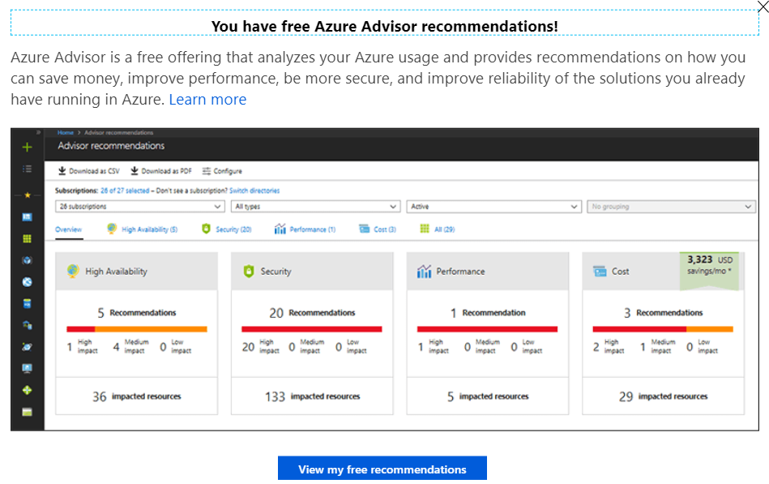
Azure Synapse Analytics recommendations
Recommendation generation (every 24 hours)
Azure Advisor Recommendation Blade
Data skew + Replicate tables
Azure Synapse Analytics
Recommendation
API
Telemetry
Stats
Tempdb
Adaptive Cache
Notes:
TALKING POINTS
Let’s see how Azure Synapse Analytics can generate recommendations
<Click>
Any query operations telemetry data is captured.
<Click>
The telemetry collected includes data skew and replicated table recommendations, statistics about the tables and columns. Information about the TempDB and information regarding the adaptive cache
<Click >
You can then use the recommendation API, or the Azure Advisor to view the recommendations that are made
PRESENTER GUIDANCE AND NOTES
This information is used to serve as a reminder of information you will need to know to present this slide
Refresh yourself with this 13 min video about the Query Store and recommendations with the following link:
https://youtu.be/1mYltCiTkmU

Slide 24

In Summary: Query Performance
Select the proper table distribution
Detect data skew
Use Query Data store
Consider changing key columns
Only as fast as your slowest distribution
Provision additional adaptive cache capacity
Reduce tempdb contention
Create and update statistics
Notes:
TALKING POINTS
In order to maximize query performance and throughput:
Select the proper table distribution – Replicate tables
Reduce data movement to increase workload performance
Detect data skew
Reconsider hash key causing physical data skew
Only as fast as your slowest distribution
Provision additional adaptive cache capacity
Increase cache hit percentage
Reduce tempdb contention
Scale or update resource class
Create and update statistics
Optimal plan selection
PRESENTER GUIDANCE AND NOTES
This information is used to serve as a reminder of information you will need to know to present this slide
Refresh yourself with this 13 min video about the Query Store and recommendations with the following link:
https://youtu.be/1mYltCiTkmU

Slide 25
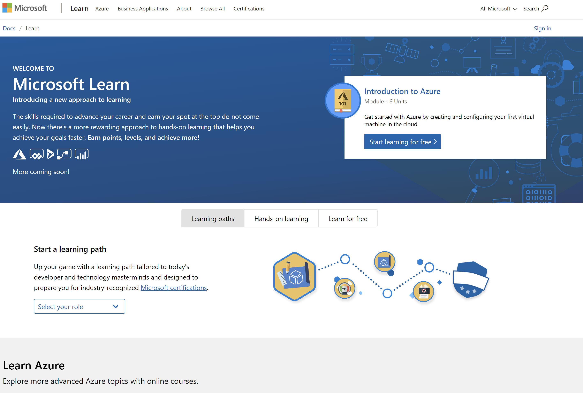
/MS Learn alert
Complete interactive learning exercises, watch videos, and practice and apply your new skills.
aka.ms/DATA50MSLearnCollection
Notes:
https://aka.ms/DATA50MSLearnCollection

Slide 26


Get Certified
Resources
Session Resources
aka.ms/DATA50
Session Code on GitHub
aka.ms/DATA50repo
All Event Resources
aka.ms/mymsignitethetour
aka.ms/azuredataengineer
#MSIgniteTheTour
Notes:
TALKING POINTS
As mentioned at the beginning of the session, we bundled all resources to this session
This Learning Path provides a step towards pursuing the Microsoft Certified: Azure Data Engineer Associate level certification.
The link to this certification, and the skills being measured on the certification exams associated with this role-based certifications are available for you here.

Slide 27
Optimize data warehousing query performance
Speaker name
Title

